Slide 1

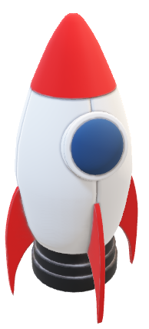

Slide 2


Slide 3


Slide 6
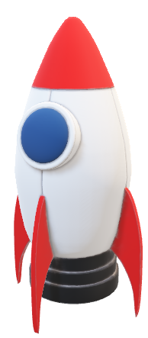

Slide 7


Slide 9


Slide 10

SPAC O

Slide 11


Slide 12
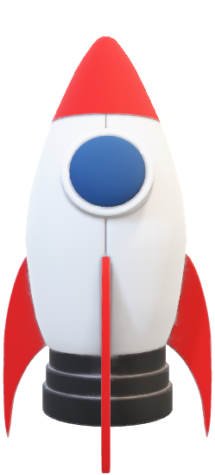
Table of contents

Slide 13




Implement
Technologies
The Team
The Task

Slide 14






The Team
Developer
Scrum Trainer
Developer
Simeon Stefanov
9B
Iva Raikova
9G
Developer
Nikol Stoqnova
9G
Natali Ribareva
9V

Slide 16


Slide 20


The Task
The Task
Spacio's primary goal is to simplify complex scientific ideas, using interactive methods. By offering both demonstrations and theoretical content, it accommodates diverse learning preferences, ensuring accessibility and engagement.
Ultimately, Spacio aims to instill a deeper understanding of science, fostering curiosity and knowledge among users.

Slide 21












Technologies
Web Development
C++ Development

Slide 22


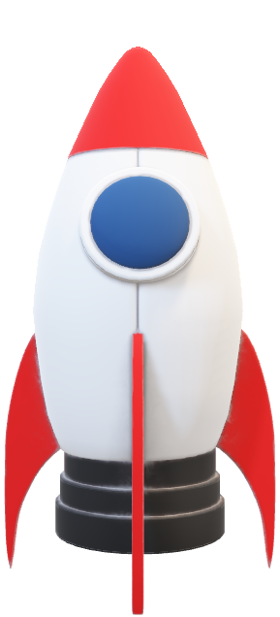

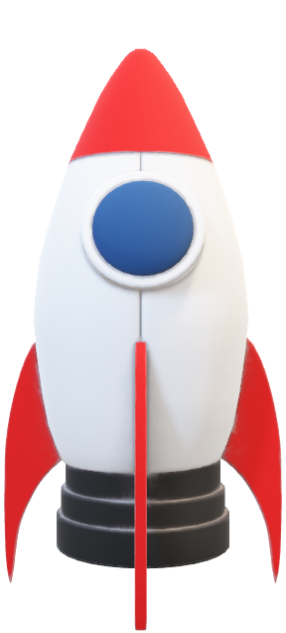

Implement
Implementing Spacio means seamlessly integrating its interactive features into educational settings, enriching the learning experience for students and supporting teachers with training sessions to maximize its benefits.

Slide 26

Let’s take a look at our project

